Slide 1
Supporting ZBNF scale-up in AP through independent research
Arunabha Ghosh
Abhishek Jain
Rythu Sadhikara Sanstha (RySS), Guntur, AP
10 April 2021
© Council on Energy, Environment and Water, 2026

Slide 2






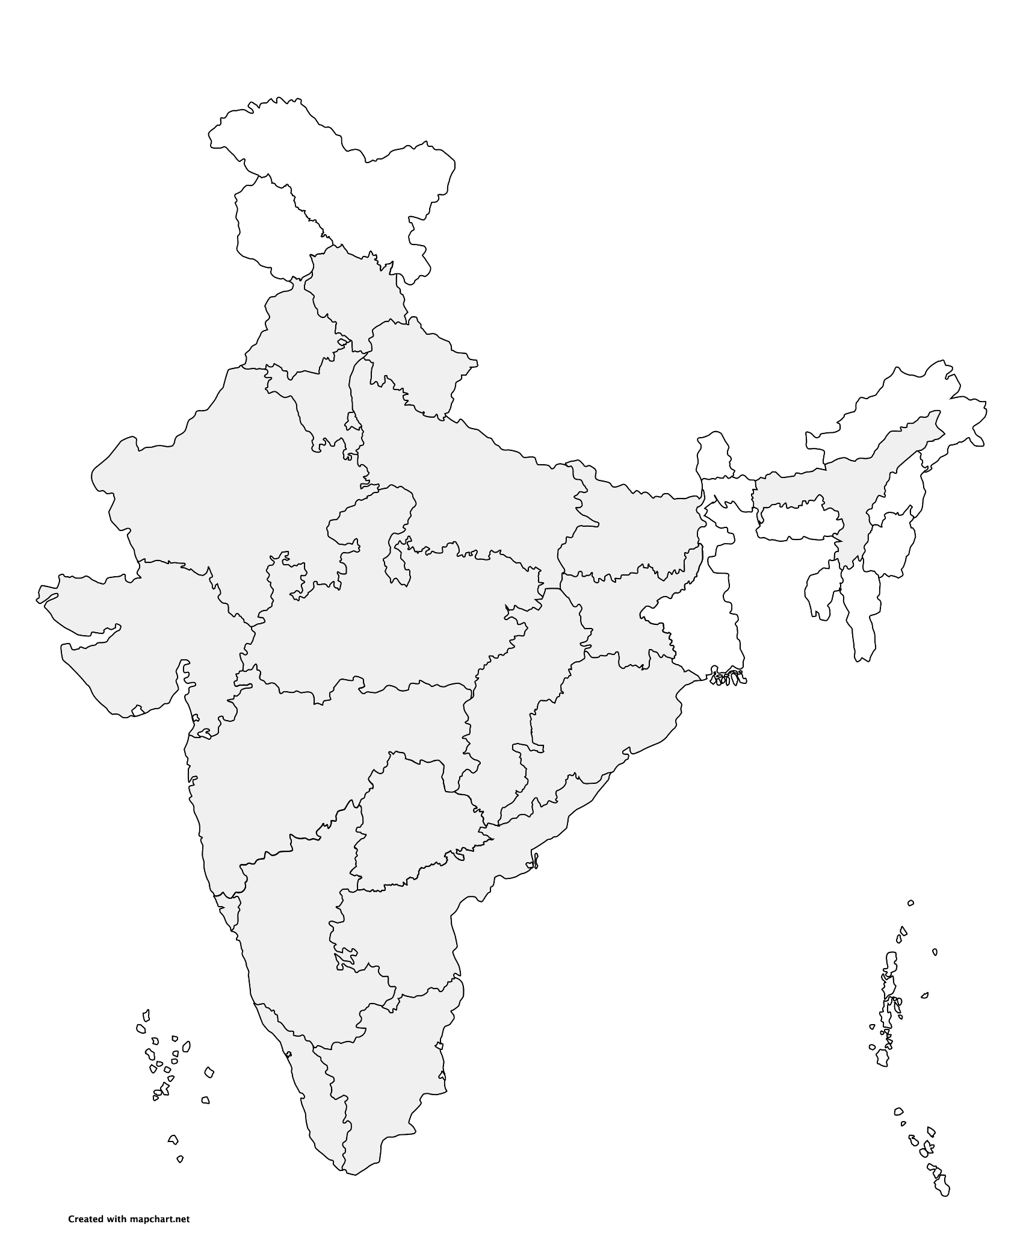
Impacting sustainable development at scale with data, integrated analysis, and strategic outreach
STRATEGIC PILLARS
Clean electricity
Low-carbon
industrialisation
Fuels of the future
Improving quality of life
Green economy & livelihoods
Sharing lessons from India
Himachal Pradesh
Resilience
Uttarakhand
Energy, Resilience
16 years
16 research teams
400+ team members
680+ peer-reviewed studies
240+ policies & plans informed
80,000+ livelihoods enabled
770+ convenings
800+ opinion pieces
52 mn reached via films & documentaries
Punjab
Air, Mobility
Assam
Energy, Livelihoods
Haryana
Air, Energy
Uttar Pradesh
Energy, Mobility, Water
Delhi
Air, Energy, Mobility
Bihar
Air, Livelihoods
Rajasthan
Air, Energy, Food, Industry, Water
Gujarat
Air, Energy, Industry, Resilience, Water
Jharkhand
Energy
Chhattisgarh
Energy, Mobility
Madhya Pradesh
Air, Energy, Food
Odisha
Energy, Livelihoods, Resilience
Maharashtra
Air, Energy, Resilience, Water
Telangana
Mobility
Goa
Resilience, Water
Karnataka
Energy
Andhra Pradesh
Resilience, Food
Kerala
Energy, Mobility
Tamil Nadu
Air, Energy, Resilience,
Water
Notes:
18 states, 52 ongoing engagements.

Slide 3
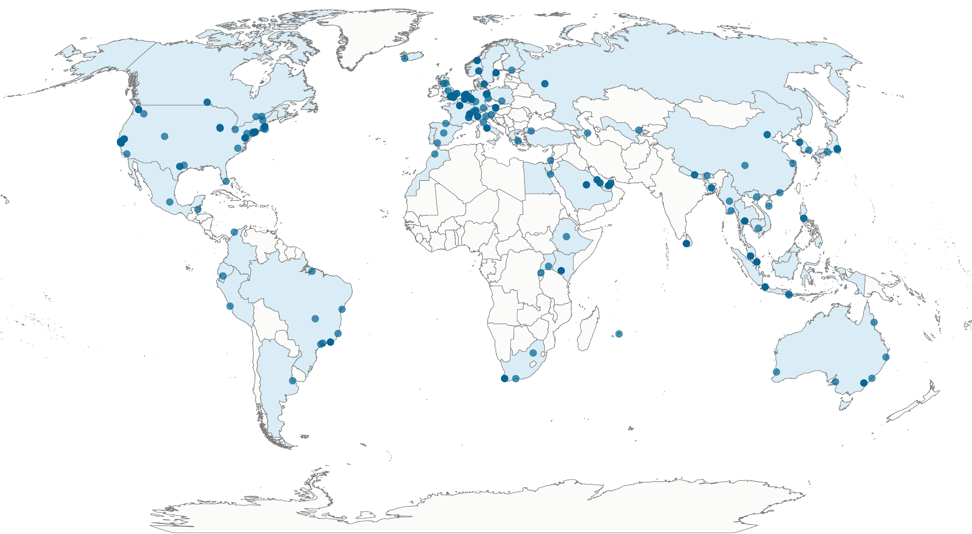
Global collaborations since 2010
60+ countries
230+ institutions
‹#›|

Slide 4

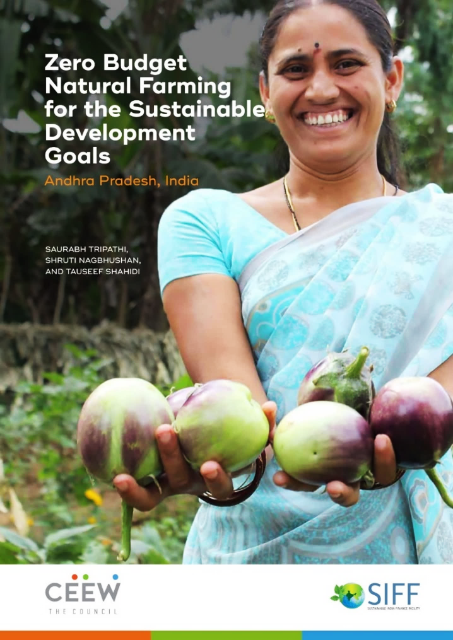
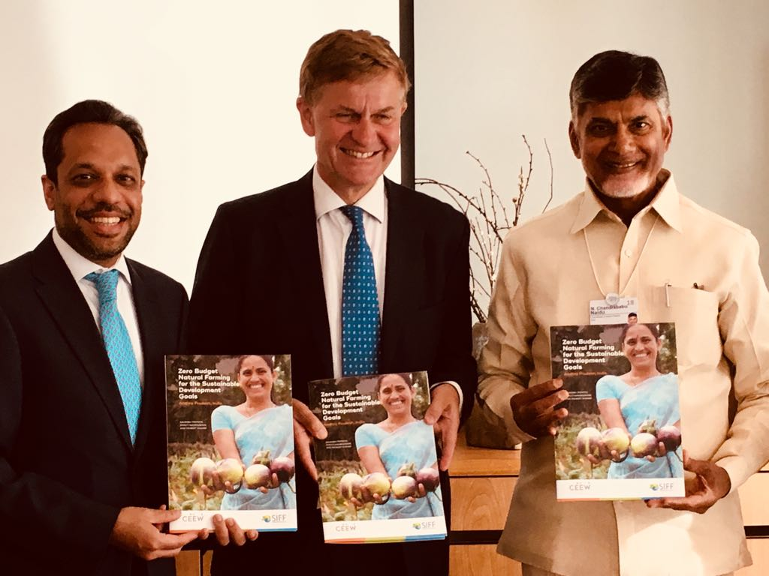
CEEW’s engagement and support has already begun
ZBNF could help AP and India make significant progress towards almost a quarter of the 169 SDG targets
Assessed the potential benefits of ZBNF in line with Sustainable Development Goals (SDGs)

Slide 5
Prospective areas of research support
Supporting the systemic scale-up
Stakeholder mapping and power analysis
System-wide monitoring & evaluation framework
Assessing financing ecosystem
Understanding implications of systemic scale-up
Assessing the economic, ecological, and social outcomes of AP ZBNF programme
Estimating and leveraging fertiliser subsidy savings
Understanding the social equity implications
Achieving co-benefits
Utilising the social capital towards achieving SDGs
Circular economy at the village level
Energy independence in villages

Slide 6
Supporting systemic scale-up
AP ZBNF programme

Slide 7
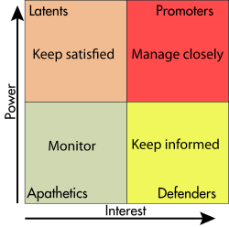
Stakeholder mapping and power analysis
Why?
To garner adequate support and mitigate potential threats to programme scale-up
How?
Identify and classify relevant stakeholder for scale-up of the programme
Assess their existing positions, narratives, and sphere of influence
Develop a stakeholder engagement strategy for the programme
Image source: Wikipedia

Slide 8
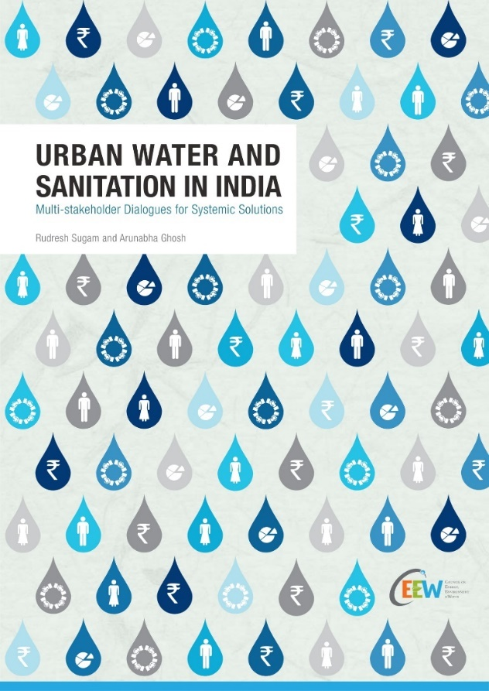
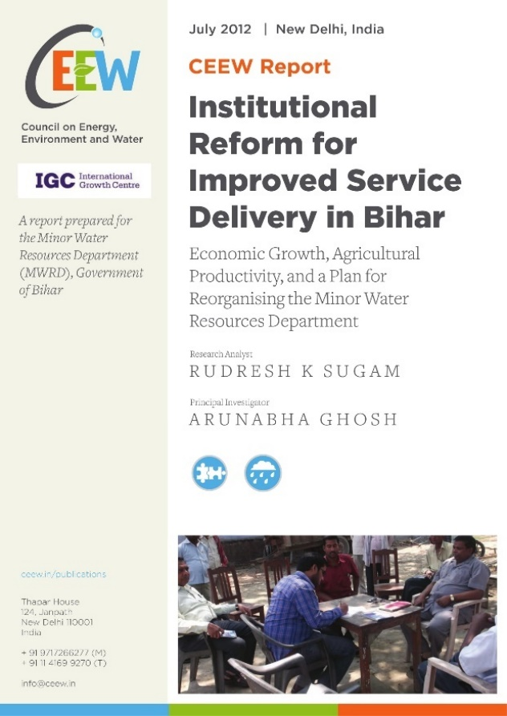
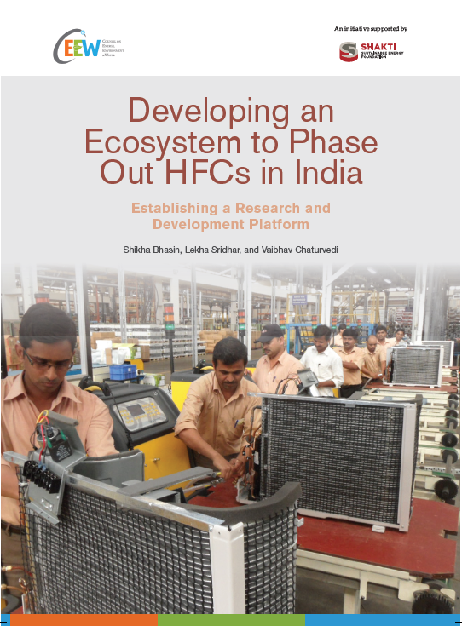
Stakeholder mapping and power analysis
Leveraging CEEW expertise and experience
On-going
Evolving the Narrative on Energy Access
Image source: Wikipedia

Slide 9
System-wide monitoring and evaluation framework
Why?
To ensure regular process and impact evaluation to not just monitor progress, but to enable course corrections as we scale up
How?
Understand the existing M&E framework
Co-build M&E framework for the programme scale-up with focus on process as well as impact evolution
List of indicators to be assessed
Methods and approaches to gather data: MIS, Surveys, GIS, Tech4Data
Evaluate impact using RCT, Differences-in-differences, experiments.

Slide 10
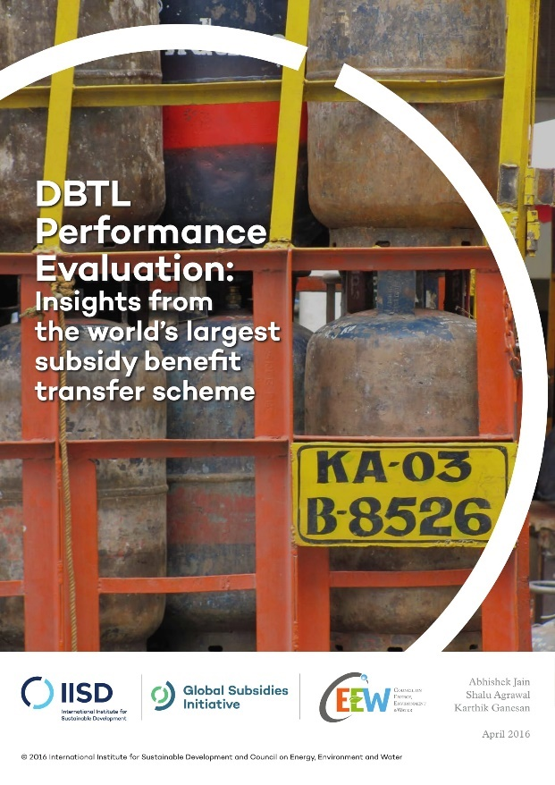
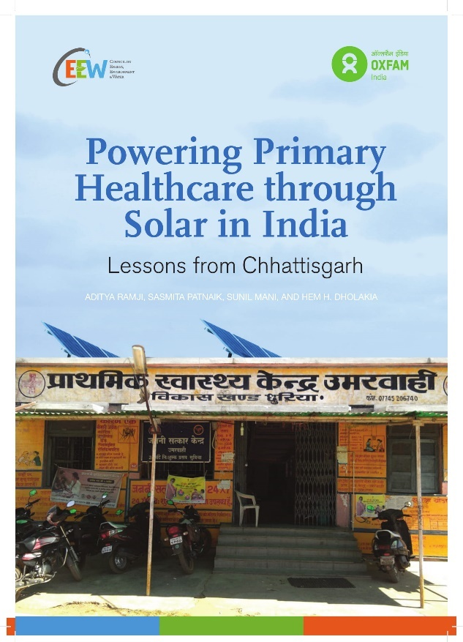
System-wide monitoring and evaluation framework
Leveraging CEEW expertise and experience
On-going
Tech4Data – Sensor-based cloud data gathering, telephonic surveys, app-based data gathering, digital surveys
M&E framework for in situ management of crop stubble in Punjab

Slide 11
Assessing the financing ecosystem
Why?
Leveraging public funds to crowd in private capital to scale the programme faster and more cost-effectively
How?
Evaluation of alternative approaches to results-based financing
Assessing feasibility of offset mechanisms as a revenue stream
Assessing risk perceptions with regards to programme financing
Designing innovative financial instruments to mitigate the risks
Assessing potential for green bonds for credit enhancement

Slide 12
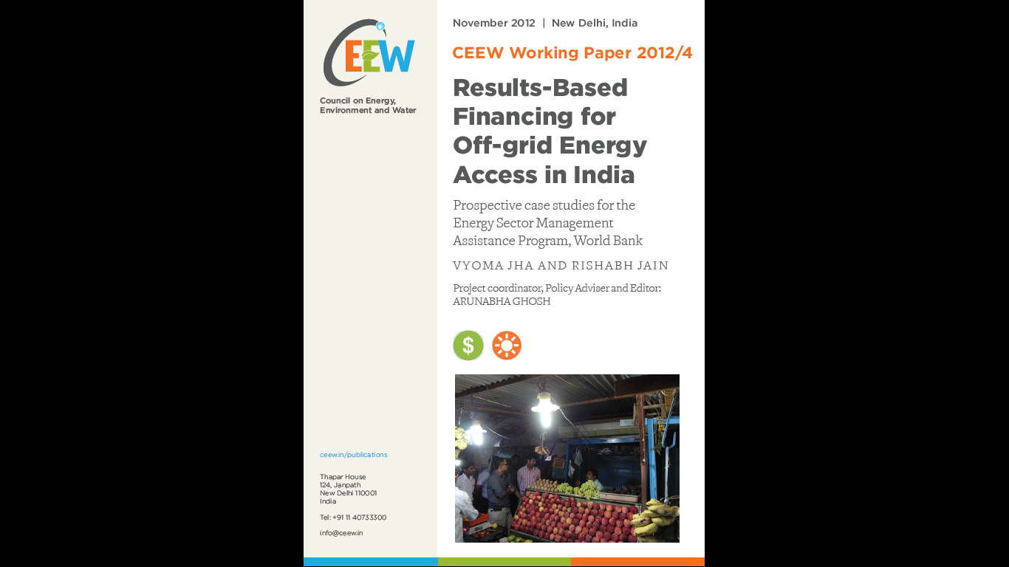
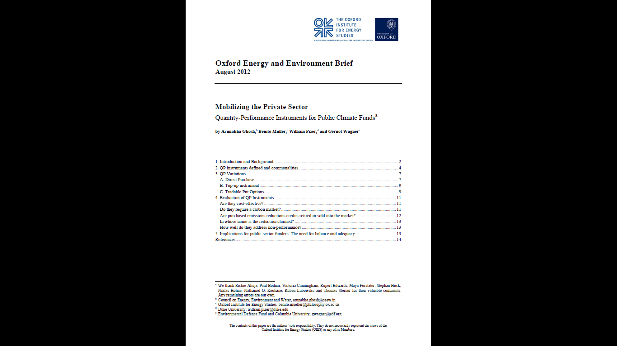
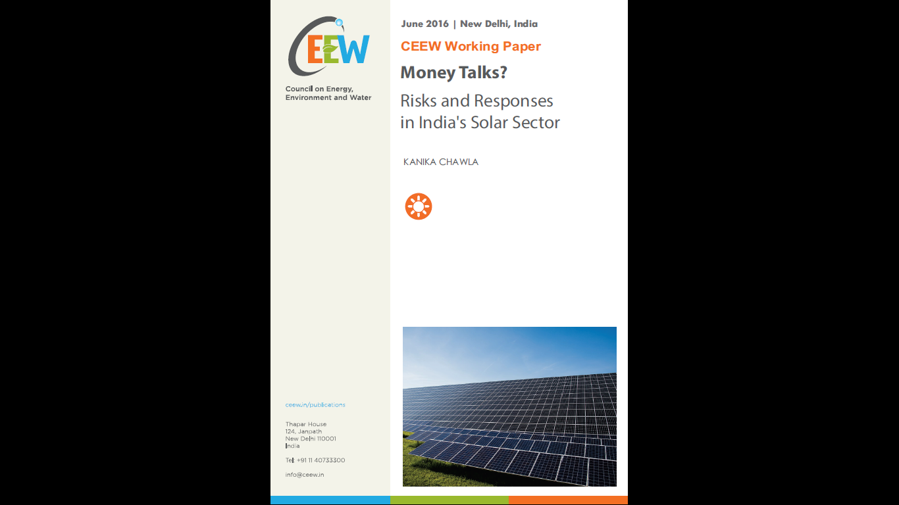
Assessing the financing ecosystem
Leveraging CEEW expertise and experience

Slide 13
Understanding implications of systemic scale-up
AP ZBNF programme

Slide 14

Economic, environmental and social cost and benefit analysis
Why?
To garner adequate support through quantification of potential costs and benefits of the programme
How?
In collaboration with other research entities (e.g. ICRAF, TEEB), quantifying and estimating the triple bottomline outcomes of the programme
Evaluate climate adaptation benefits of ZBNF
Assess ZBNF impact on water in Andhra Pradesh
Estimate and leverage fertiliser subsidy savings
Image source: realbuildingconsulting.com

Slide 15
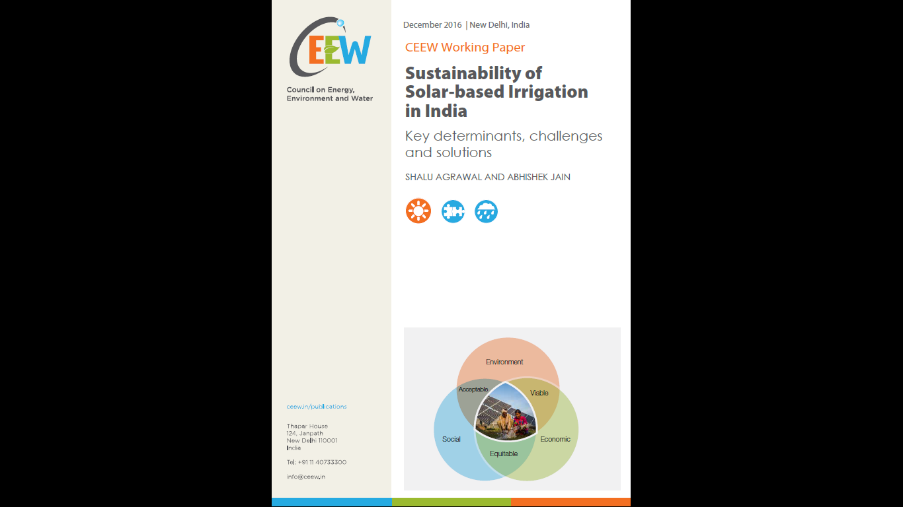
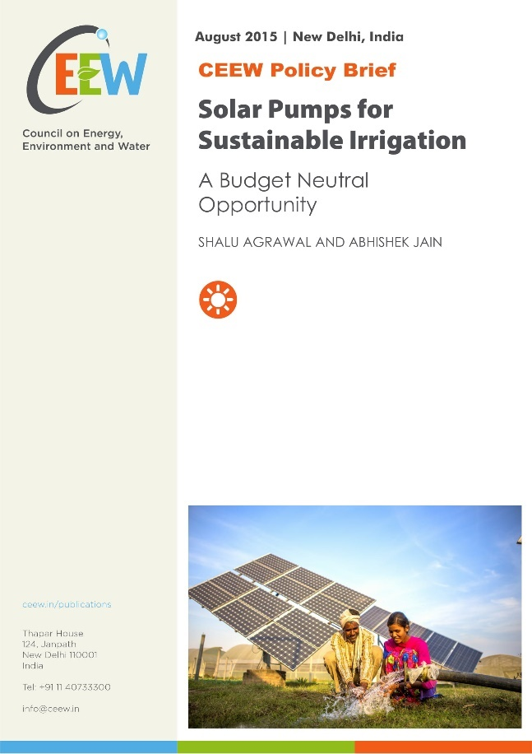
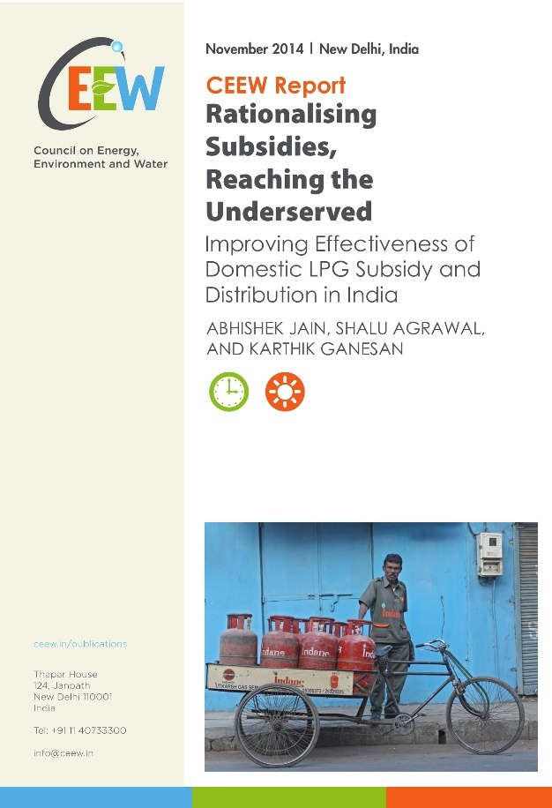

Economic, environmental and social cost and benefit analysis
Leveraging CEEW expertise and experience

Slide 16



Social equity implications of AP ZBNF programme
Why?
To understand the unintended social inequity implications of the programme; to guide programme design to reduce social inequity
How?
Study programme implications on farm-labour requirement, wages, and rural employment market
Analyse impact on female farmers and labourers
Assess relative gains of landless, marginal, small and medium farmers vis-à-vis large farmers
Analyse implications of premium pricing of ZBNF produce on food affordability of poor and marginal

Slide 17
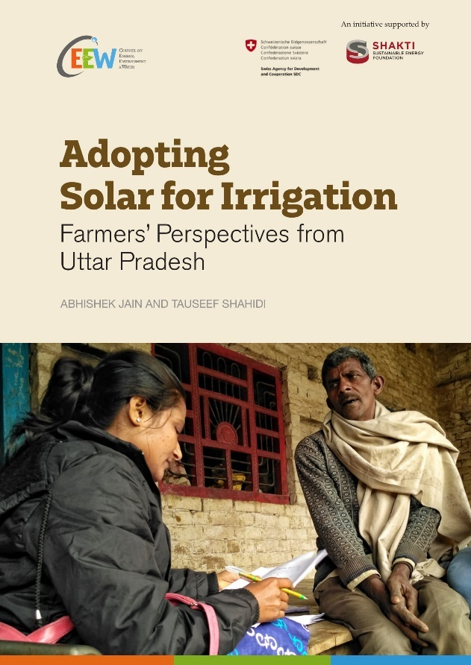
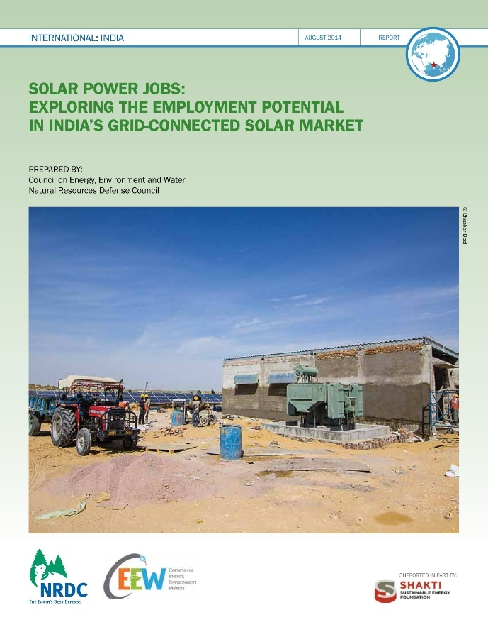
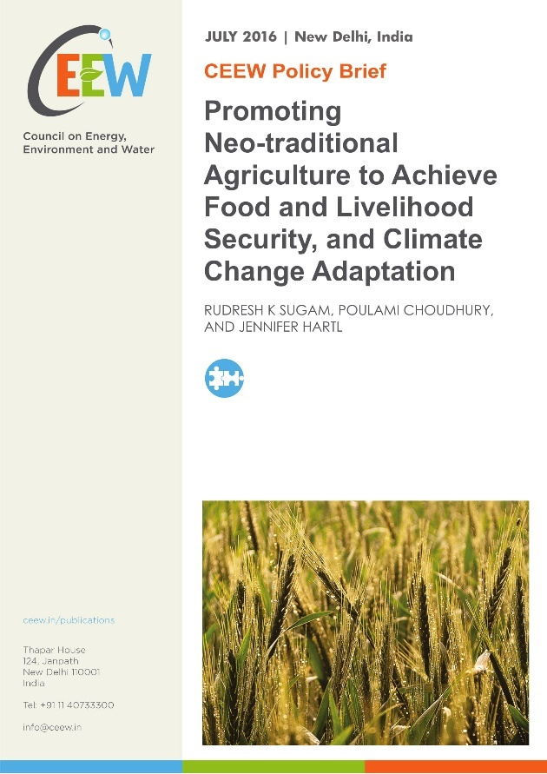
Social equity implications of AP ZBNF programme
Leveraging CEEW expertise and experience

Slide 18
Achieving co-benefits
AP ZBNF programme

Slide 19
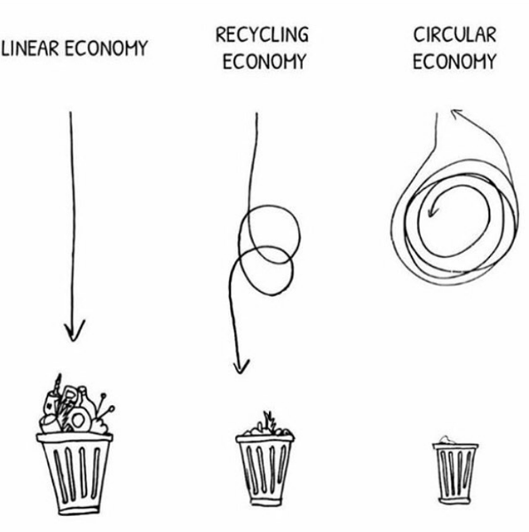
Circular economy at the village level
Why?
Leveraging the social capital under the ZBNF programme to realise self-sufficient villages
How?
Understanding consumption needs and mapping the resources at the village level
Assessing the best practices to match village-level resources with the local needs
Energy
Water
Food

Slide 20
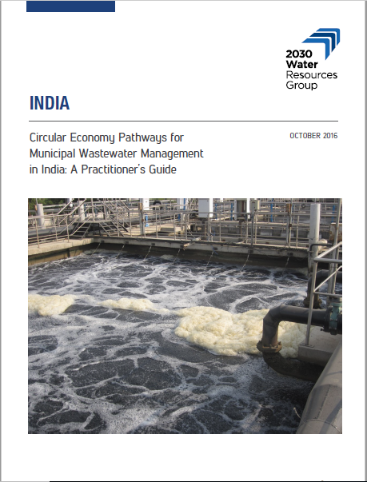
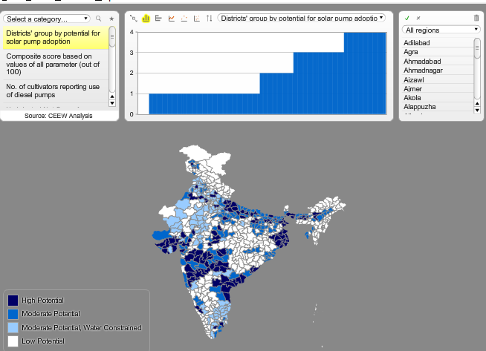
Circular economy at the village level
Leveraging CEEW expertise and experience

Slide 21
Circular economy: Energy-independent villages
How?
Understanding the consumption needs and mapping resources at the village level
Bioenergy: Excess agri-residue, waste biomass, and cow-dung (not used in-situ) for energy production through biomass gasification, bio-ethanol and biogas
Energy-as-a-service: Village-level energy enterprises
Leveraging energy efficiency towards energy independence
For instance in ZBNF micro-enterprises
Avoiding free-of-cost biomass for cooking
Generating livelihood alternatives to help put an economic value towards time-spent biomass collection and biomass-based cooking

Slide 22
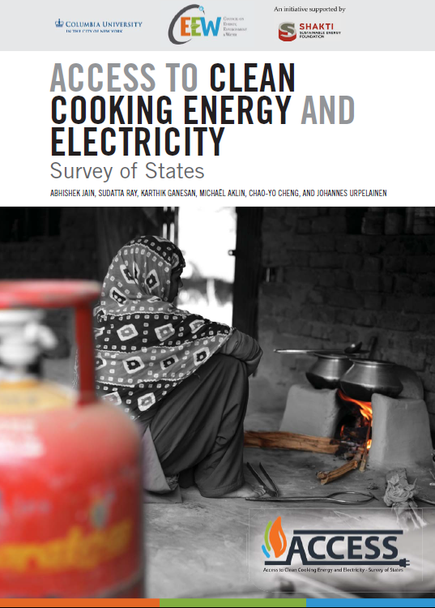
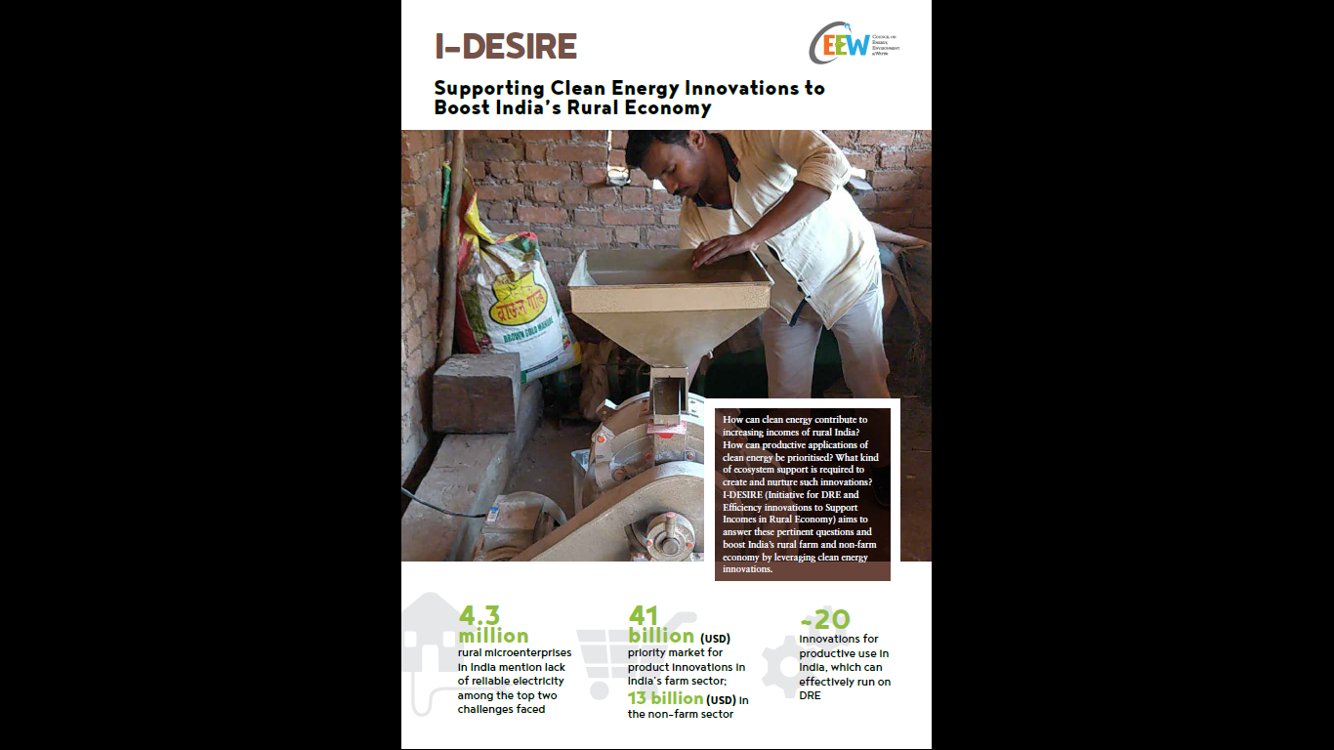
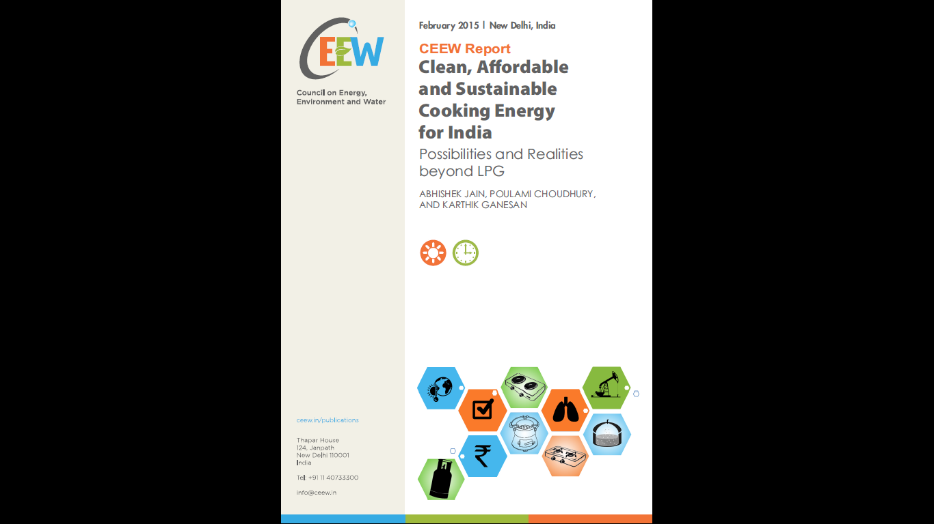
Circular economy: Energy-independent villages
Leveraging CEEW expertise and experience

Slide 23
Sequencing the research support
 | Phase I (1-9 months) | Phase II (9 – 18 months) | Phase III (18+ months)
Supporting the scale-up | Stakeholder mapping and power analysis Developing M&E framework | Evaluations against M&E framework Assessing financing ecosystem
Understanding implications of scale-up | Estimating and leveraging fertilisers subsidy savings | Triple bottom-line CBA Understanding social equity implications
Achieving co-benefits | Village level resource mapping and needs assessment | Developing village resource management plans – circular economy for energy | Evaluating implementation & impact of circular economy plans

Slide 24
Thank you
ceew.in | @CEEWIndia

